Slide 1

Sym Train Simulation Intelligent Assistant
Automated customer support pipeline
E. Kerschner
I. Lwamba
A. Ruffin

Slide 2
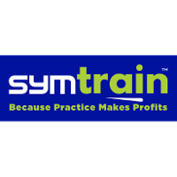



PROBLEM STATEMENT
WHAT IS SYM TRAIN?
THE PROBLEM
SOLUTION
SaaS platform for customer service and sales contact centers
Uses AI simulations (“Syms”) instead of classroom or role-play training
Lets agents practice real call/chat scenarios in a safe environment
Thousands of unstructured simulation transcripts
Manual review is slow, error-prone, and not scalable
Traditional quality monitoring lacks timely, actionable insights
Inconsistent scoring and feedback affect agent performance
Automated NLP pipeline using Retrieval-Augmented Generation (RAG)
Categorizes customer intent
Extracts resolution steps from transcripts

Slide 3
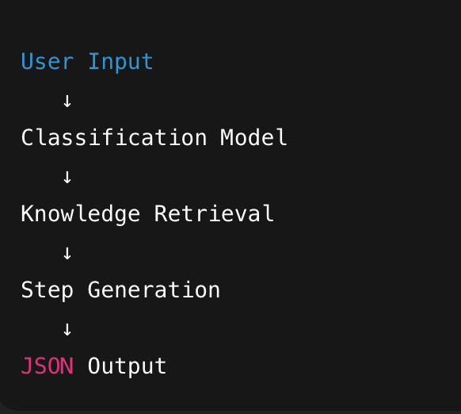

SYSTEM ARCHITECTURE
TECH STACK
STREAMLIT
HUGGINGFACE (BART-LARGE)
OPEN AI (FOR COMPARISON)
PANDAS

Slide 4
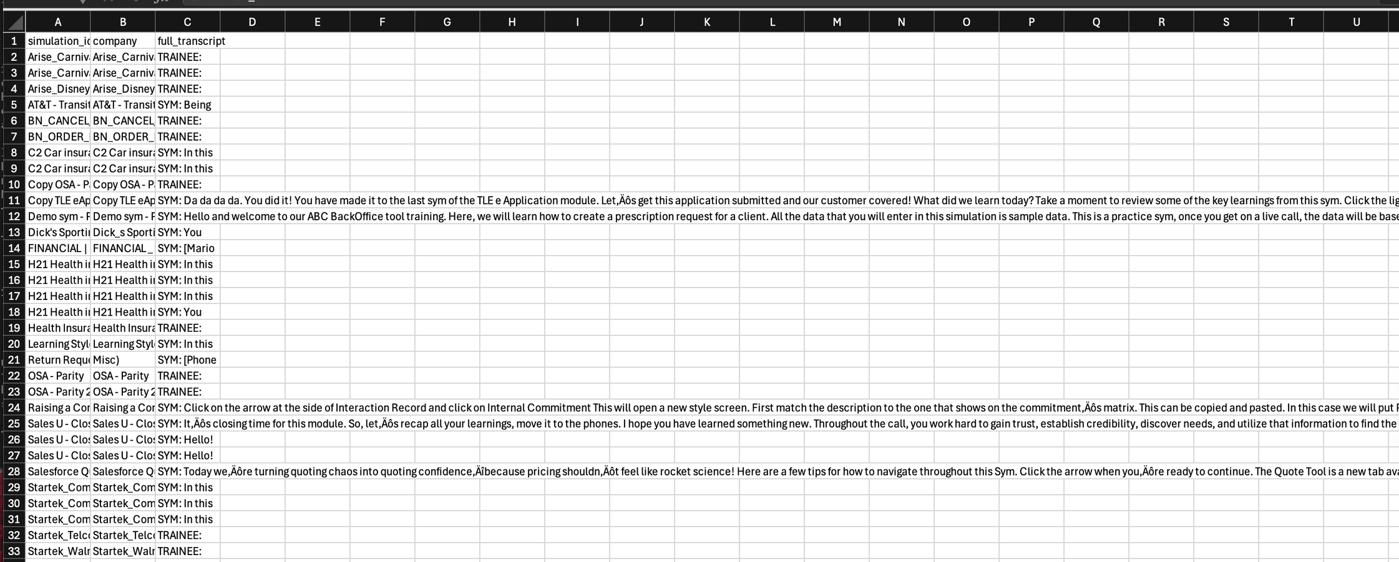
Data Engineering
CRITICAL ISSUE: The "Overwrite Bug." Raw data contained 38 zip files where internal JSONs shared duplicate names, leading to data loss during standard extraction.
FIX: Developed a custom data_loader.py "Rescue Script" to sanitize, rename, and structure the dataset into a clean Knowledge Base.

Slide 5



MODEL COMPARISON: KEY FINDINGS
Local (BART Large)
GPT-4o
Fast, free, privacy-preserving
Good for broad summarization
Higher cost
better structured JSON formatting
We chose the local approach for cost efficiency and higher data privacy

Slide 6
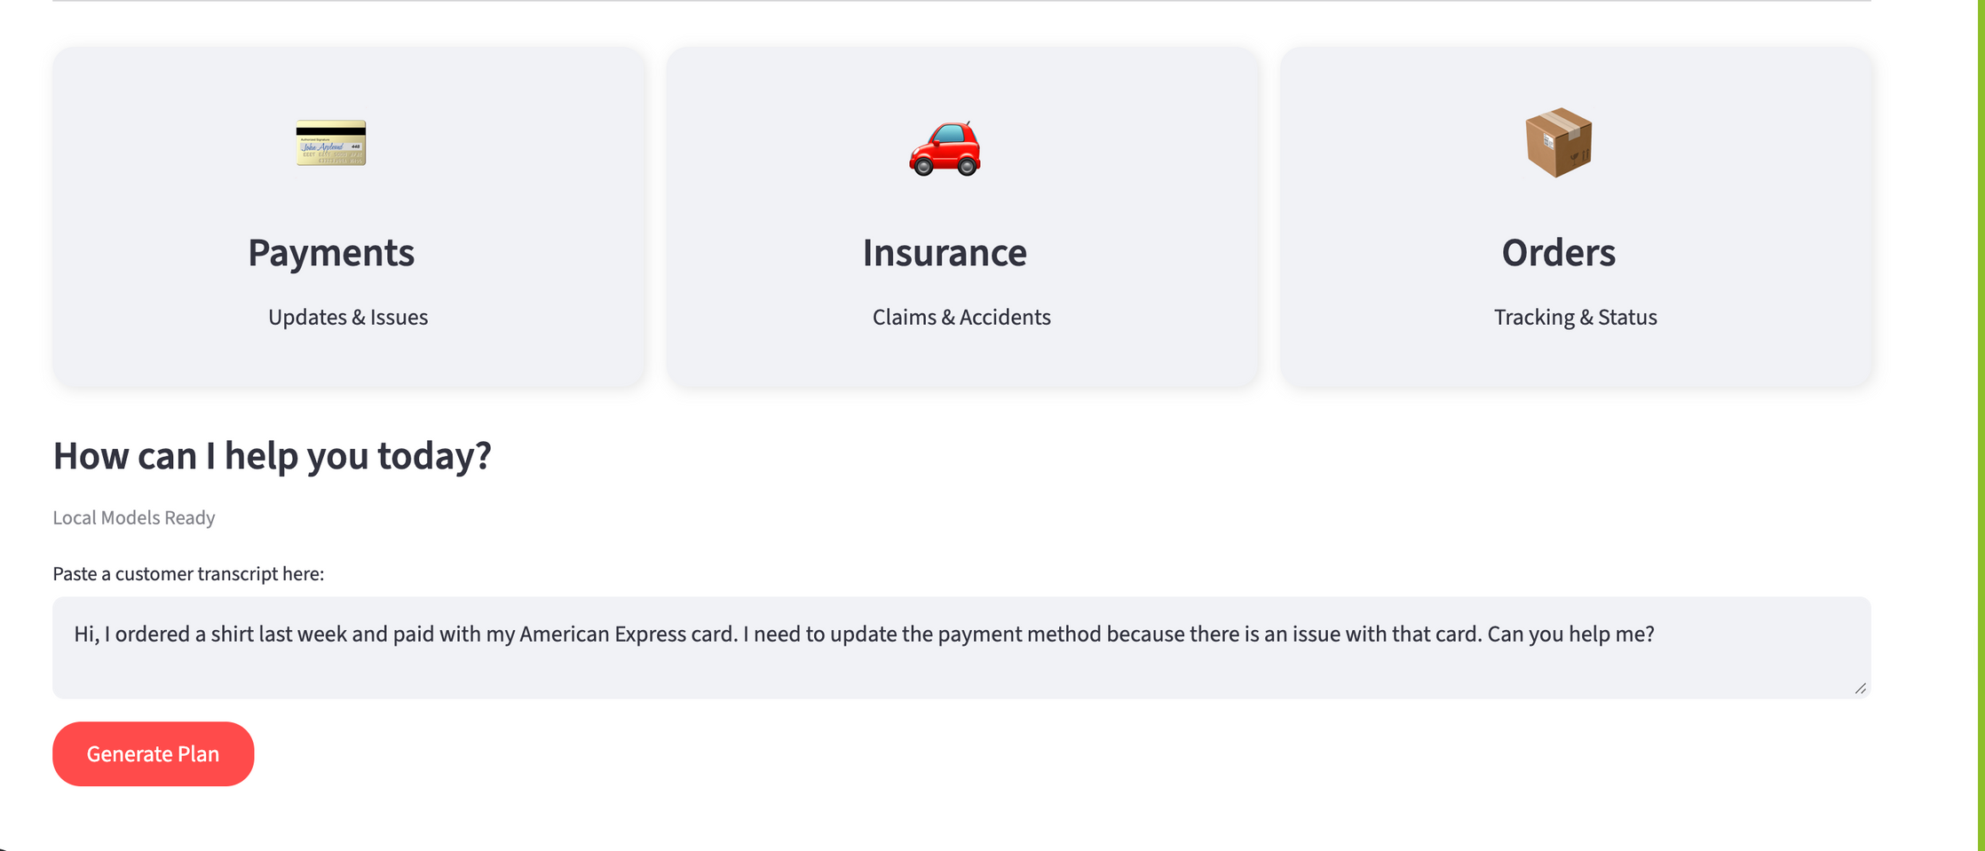
APPLICATION DEMO

Slide 7
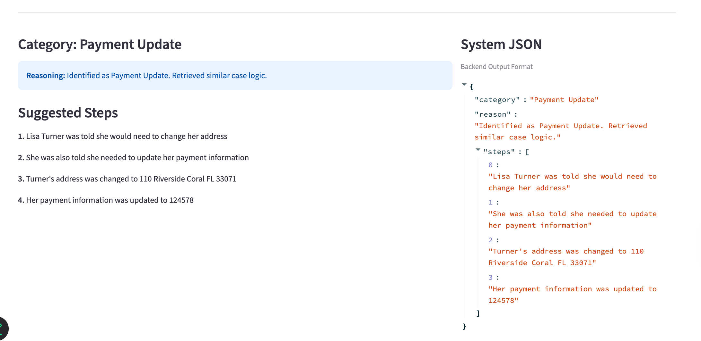
APPLICATION DEMO

Slide 8
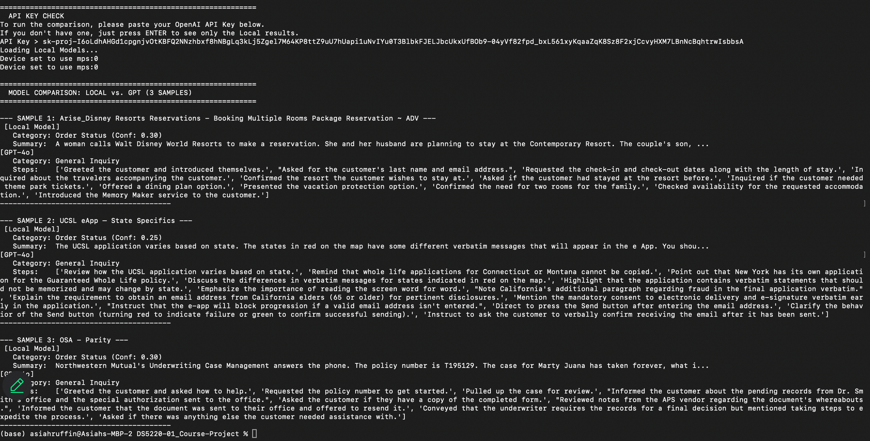
APPLICATION DEMO

Slide 9
CONCLUSION
WHAT WE ACHIEVED
IMPLICATIONS
Successfully parsed 38 simulations, handled data extraction errors and built a functional user interface
Scales transcript review without added labor
Provides consistent, unbiased evaluation of agent performance
Speeds identification of trends, coaching needs, and quality issues
Improves customer experience through faster feedback cycles
Enables data-driven training strategy instead of manual guesswork
Reduces cost of training and quality monitoring
Can integrate with existing contact center workflows and KPIs
NEXT STEPS
Integrate vision API for image analysis

